Slide 1
Firstly, you need to buy token
DeepSeek 开放平台
And download this software
CC Switch 官方网站 - AI 编程工具统一管理平台
The following materials are required for reimbursement:
Invoice;
Purchase records and payment records;
If foreign currency payment is involved, please provide the exchange rate of the Bank of China on the date of purchase and convert the amount into RMB according to the exchange rate of that day.
Please send them to me by email in a ZIP file format.

Slide 2
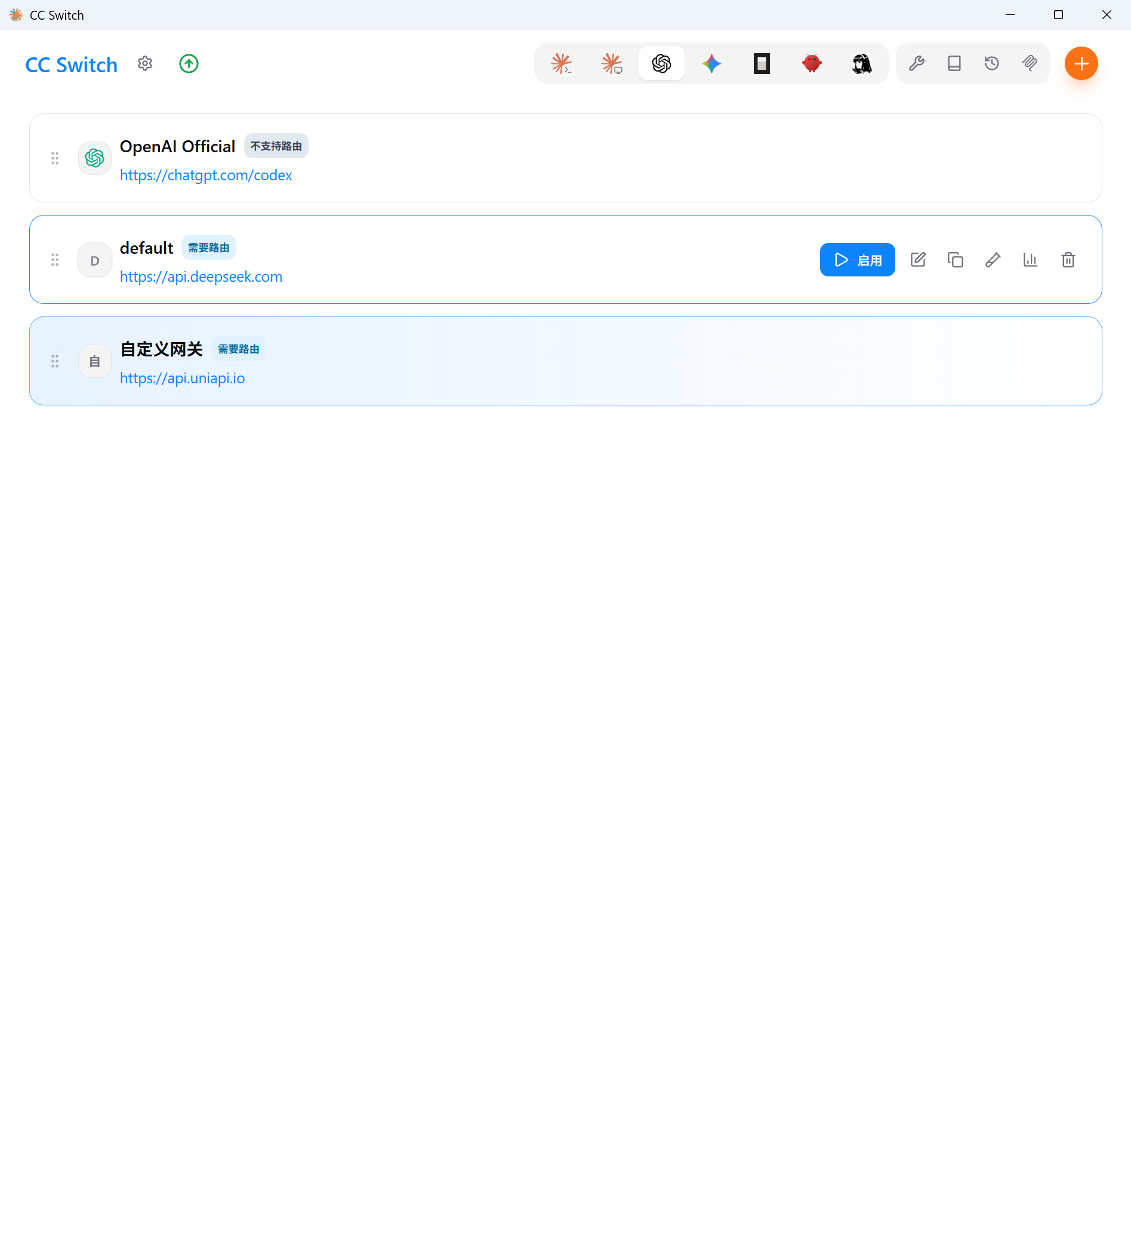
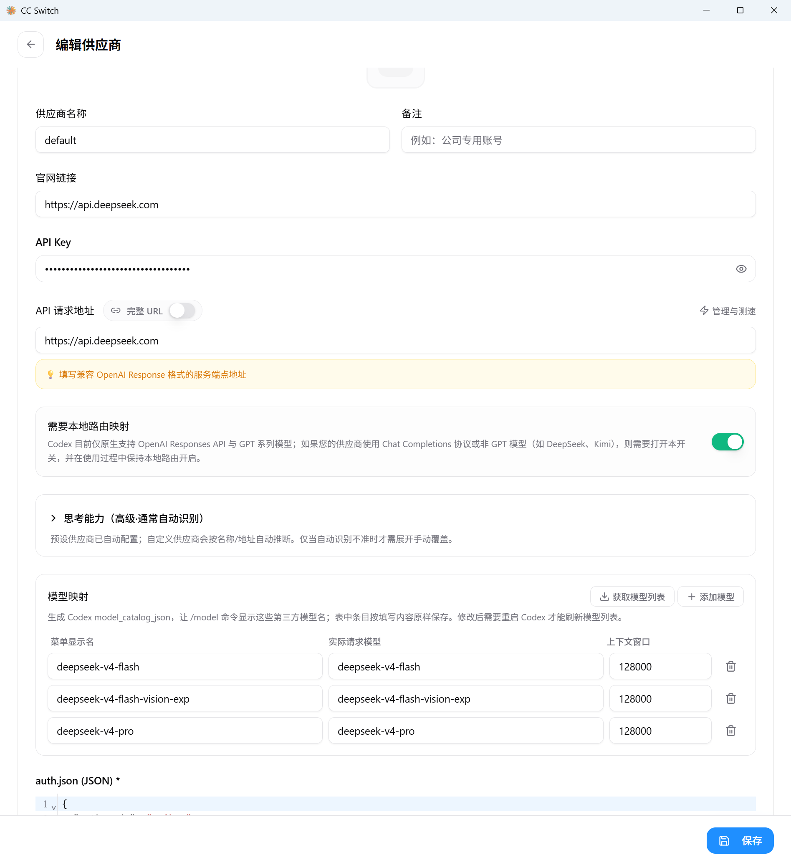
Download CC Switch and Configure API

Slide 3
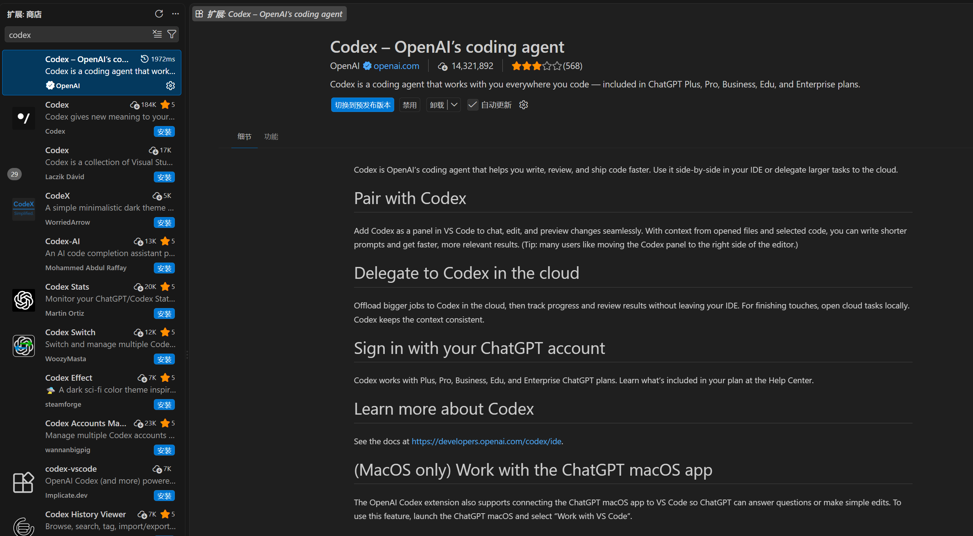
https://api.deepseek.com

Slide 4
Candidate Information Extraction & AI-Assisted Analysis
2026.9.16
01
Notes:
This project asks you to organize candidates’ CVs and public materials into profiles that are easy to understand and search. In addition to extracting facts, you may use AI to enrich background information, analyze individual contributions, and form evidence-based preliminary evaluations. The requirements and reference interface shown today are only starting points; you are encouraged to improve them based on your own understanding.

Slide 5
Project Objectives & Use Cases
Help reviewers quickly understand each candidate
Input Materials
Suggestive Outputs
We provide: CV, teaching statement ,research statement, cover letter
From provided materials:
Personal website
Project and code links
GitHub profile
Structured candidate profile
Background analysis with source attribution
Overall Evaluation & Dimension Scores
Searchable key-information tags
… and more
Output format: prioritize readability; slides are recommended
02
Notes:
The input can start from a single CV and be supplemented with reliable public information as needed. The output should support both quick browsing and deeper inspection: the first page should make the candidate’s key experiences easy to understand, while each record should allow reviewers to inspect sources, analysis, and items that still need verification. The project may take the form of a webpage, a tool, or an interactive report; each team may choose its own format.

Slide 6
Main Component
This is not a standard answer. You may design the page structure, analysis approach, and feature scope yourselves.
01
Basic Information
Basic profile, scores, strengths, items to verify, and tags
02
Education & Work Experience
Education, advisor information, employment timeline, and project details
03
Awards & Research Funding
Awards, funded projects
04
Publications
Reviewing, service roles, publications, and impact metrics
05
Overall Evaluation
03
Notes:
This long image is a reference result prepared by the instructor. Here, the thumbnail is used only to show which modules appear on the full page; students are not expected to read the small text in the image. Clearer cropped examples are shown later. Please emphasize that the existing example is not an interface that must be replicated, nor does it imply endorsement of a particular scoring method. You may reorganize the information, add useful functions, or use a completely different presentation approach.
Sources
User-provided image: 9ca86b6e3daf3ea4db8ef265ba763c30(2).png. The full-page image is only 221 pixels wide and is used here as a structural overview.

Slide 7
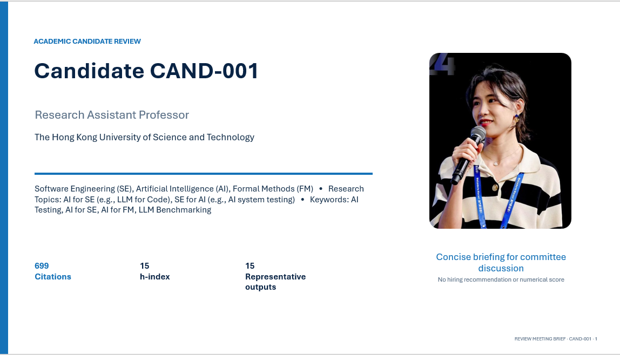
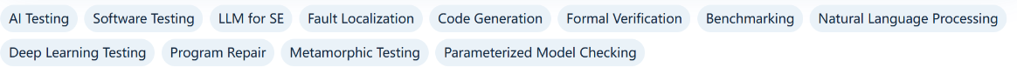
Basic Information
Profile Information to Extract
Name
Current institution, position, and research areas
Highest degree and key skills
04
Notes:
For basic information, define the fields first and then decide how to present them. Tags should be grounded in specific evidence from the materials, such as research topics, technologies used, and roles held. It is recommended to normalize synonymous Chinese and English terms; for example, “LLM” and “large language model” can be grouped under the same topic. Reviewers should be able to combine multiple conditions in a query. Keep a “to be verified” status for uncertain tags to avoid treating AI guesses as established facts.
Sources
User-provided image: 7a371dcf103c85cf1b548ec2af378164(1).png, cropped from the tag section at the bottom.

Slide 8
Education Background: Information Extraction & Context Enrichment
Content | Information to Extract or Supplement | Suggested Evidence
Degree & Major | Institution, school/department, major, degree, and dates | CV, university webpages
Advisor Relationship | Advisor name, supervisory relationship, and research area | Advisor webpage, thesis/dissertation
Institution Background | Overall ranking, ranking system, and year | Official ranking source
Discipline Background | Relevant subject ranking | Subject ranking
05
Notes:
This module has two layers. The first extracts factual information such as degrees and majors; the second enriches the profile with advisor relationships and institutional or disciplinary context. An advisor relationship should be confirmed by a webpage or thesis/dissertation that explicitly states the supervisory relationship; co-authorship alone is not sufficient evidence. Rankings should include clickable links and record the ranking system, edition year, and relevant discipline so that different rankings or years are not mixed. Rankings provide context only; individual contributions should be analyzed separately.
Sources
Optional official entry points: QS Subject Rankings https://www.topuniversities.com/subject-rankings ; THE World University Rankings https://www.timeshighereducation.com/world-university-rankings . Accessed: 2026-09-11.

Slide 9
BACKGROUND
Academic background and research trajectory
Sep 2019 – Mar 2024
Ph.D. · The Hong Kong University of Science and Technology
Reviewer view
Department of Computer Science and Engineering Prof. Shing-Chi Cheung, IEEE Fellow, ACM Distinguished Member AI Testing, Software Testing, LLM for SE
Research spans AI testing, software testing, and LLM for software engineering, with a doctoral foundation in automatic testing and fault localization for NLP systems and a current focus on LLM-driven code generation, benchmarking, and formal verification.
Sep 2016 – Sep 2019
M.S. · University of Chinese Academy of Sciences
State Key Laboratory of Computer Science, Institute of Software, Chinese Academy of Sciences Prof. Yongjian Li Formal Verification, Parameterized Model Checking
Sep 2012 – Jun 2016
B.S. · Shandong University
School of Mechanical, Electrical & Information Engineering, Computer Science Department
Chair Professor
IEEE Fellow
ACM Distinguished Member
Associate Professor
State Key Laboratory
REVIEW MEETING BRIEF · CAND-001 · 2
Notes:
Sources
https://cse.hkust.edu.hk/faculty/scc/
https://lcs.ios.ac.cn/~lyj238/index_e.html
https://www.en.sdu.edu.cn/About_SDU/Introduction.htm

Slide 10
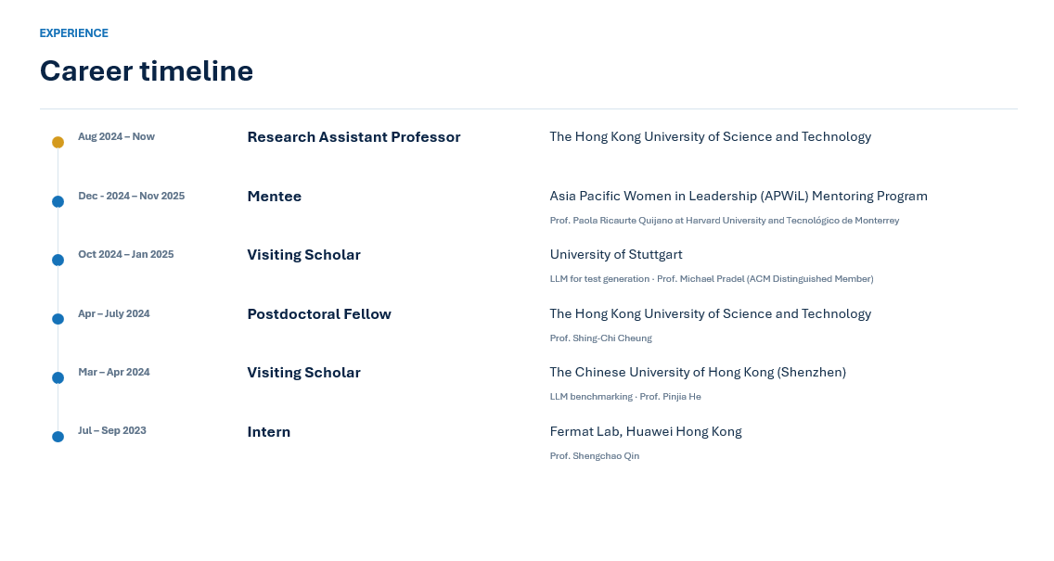
Work Experience Timeline
For each role, record: start date, end date, responsibilities, outcomes, and sources
06
Notes:
The purpose of the timeline is to make the progression and overlap of experiences clear, rather than simply listing organizations in chronological order. Each experience should be expandable to show responsibilities, projects, and actual outcomes. Visiting, part-time, and full-time roles may overlap, so overlapping dates should not automatically be treated as errors. When a source gives only a year, preserve that level of precision rather than inventing a month. The table is only used here to explain chronological order; your final implementation may use an interactive timeline.

Slide 11
Awards & Funding: Record Facts and Clarify Individual Roles
Awards
Funding & Grants
Award name, year, and awarding organization
Where possible, include a hyperlink to the award’s official webpage.
Project title and funding agency
Project period, amount, and currency
PI, co-PI, or participant
Research scope and actual responsibilities
Key Analysis
Relevance to the candidate’s research direction and their actual contribution
08
Notes:
For awards and funding, first extract the records completely and then add contextual information. You may explain the scope of an award, the purpose of a grant, and publicly available review information, but do not invent acceptance rates or rank awards into tiers without evidence. Preserve the currency for funding amounts and distinguish total project funding from the portion actually managed by the candidate. Being a PI, co-PI, or regular participant implies different levels of individual contribution.

Slide 12
RECOGNITION
Awards and funding
Awards
Funding
2025
ACM SIGSOFT Outstanding Doctoral Dissertation Award
2025/26
A Multi-faceted Framework for Automated Pseudocode-to-Code Translation using Large Language Models
SIGSOFT presents this annual award for outstanding doctoral dissertations in software engineering. The official 2025 recipients list includes this dissertation, so this is a direc…
Co-PI · HK$ 1,590,700 · Research Grants Council of Hong Kong
2024
ACM Distinguished paper award (ASE)
2023.12.21 – 2025.05.06
Large language models driven Test Oracle Generation
ACM SIGSOFT allows a small subset of accepted papers at sponsored conferences, including ASE, to receive Distinguished Paper Awards. Under the published rule, conferences with mor…
Key contributor · HK$ 1,430,000
2019 - 2021
Huawei Fellowship Scholarship
2024.01.19 – 2025.04.23
From requirements to formal modeling verification projects based on large language models
HK$ 1,380,000
2023 - 2024
Hong Kong Postgraduate Scholarship
2024.10.30 – Now
Large language models aided program abstraction and model checking
HK$ 80,000
REVIEW MEETING BRIEF · CAND-001 · 5
Notes:
Sources
https://www2.sigsoft.org/awards/dissertation/
https://www2.sigsoft.org/awards/distinguishedpaper/

Slide 13
Publications, Citations & Open-Source Outputs
Information Level | Suggested Information to Extract or Add
Publication Details | Title, year, DOI, paper link, and publication status
Individual Contribution | Author order and explicit evidence for co-first or corresponding authorship
Publication & Citation Context | Journal or conference, field/context, citation count
Related Code & Projects | GitHub repository link, Stars,
Add the query date for citation counts and Stars; show a missing status if unavailable.
Publications can be ranked by impact factor, journal quartile, or conference category.
09
Notes:
In addition to basic bibliographic information, the publication module should help readers understand individual contributions and research impact. Citation counts should identify the database and the query date. The relationship between a publication and a repository should be supported by evidence such as a paper link or project webpage. GitHub Stars indicate attention but should be interpreted together with code content, maintenance status, and the candidate’s contribution. If no public code exists, a query fails, or an item has not yet been indexed, mark it as missing rather than treating it as zero.
Sources
Official entry points: Crossref REST API https://www.crossref.org/documentation/retrieve-metadata/rest-api/ ; OpenAlex Works https://help.openalex.org/data/works/ ; GitHub Repositories REST API https://docs.github.com/en/rest/repos/repos . Accessed: 2026-09-11.

Slide 14
RESEARCH
Representative research outputs
01
Enchanting program specification synthesis by large language models using static analysis and program verification
57 Citations
International Conference on Computer Aided Verification · 2024 · Corresponding author · CCF A
DOI 10.1007/978-3-031-65630-9_16
02
A study on prompt design, advantages and limitations of ChatGPT for deep learning program repair
32 Citations
Automated Software Engineering · 2025 · First author · CCF B
DOI 10.1007/s10515-025-00492-x
03
Javabench: A benchmark of object-oriented code generation for evaluating large language models
11 Citations
Proceedings of the 39th IEEE/ACM International Conference on Automated Software… · 2024 · First author · CCF A
DOI 10.1145/3691620.3695470
04
CRUXEVAL-X: A Benchmark for Multilingual Code Reasoning, Understanding and Execution
9 Citations
Proceedings of the 63rd Annual Meeting of the Association for Computational Lin… · 2025 · Co-first author · CCF A
DOI 10.18653/v1/2025.acl-long.1158
REVIEW MEETING BRIEF · CAND-001 · 4
Notes:
Sources
https://openalex.org/W4400939349
https://www.ccf.org.cn/Academic_Evaluation/TCS/
https://openalex.org/W4408175000
https://www.ccf.org.cn/Academic_Evaluation/TCSE_SS_PDL/
https://openalex.org/W4403536900
https://openalex.org/W4412944815
https://www.ccf.org.cn/Academic_Evaluation/AI/

Slide 15
COMMITTEE DISCUSSION
Reviewer assessment
The candidate presents a coherent and well-documented profile in software engineering, AI testing, and formal verification, with strong evidence of research productivity, teaching experience, and funding acquisition. The application materials are largely consistent, though some claims in the cover letter and research statement lack full support in the CV or are not independently verified. The teaching statement provides concrete metrics and student feedback, while the research statement outlines a clear agenda with specific contributions. Cross-document consistency is generally high, but a few discrepancies and unsupported claims warrant att…
Research assessment
Teaching assessment
Application narrative
The candidate has a strong research record in software engineering, AI testing, and formal verification, evidenced by first-author publications in top venues (ICSE, FSE, ASE, TOSEM, ACL, AAAI, CAV) and a 2025 ACM SIGSOFT Outstanding Doctoral Dissertation Award. The research statement articulates a focused ag…
The teaching statement provides concrete evidence of teaching effectiveness, including instructor roles for COMP1021 (110 students) and a Nankai University guest course (228 students), with evaluation scores (4.22/5) above course and university averages. Student feedback and attendance metrics support engage…
The cover letter effectively highlights the candidate's research productivity, teaching experience, funding, and awards, aligning them with the target institution's goals. It provides specific metrics (e.g., 31 publications, HK$2.89 million in funding) and emphasizes prestigious awards. However, the letter's…
Discussion aid only. The deck does not contain a hiring recommendation or numerical score.
REVIEW MEETING BRIEF · CAND-001 · 7
Notes:
Source: candidate application materials and structured profile data.

Slide 16
More Consideration
Presenting Sources & Uncertainty
  Every key record should trace back to the original material or an accessible webpage, Identity verification can combine institution, discipline, time period, collaborators, and personal homepage.
Flexible Search & Candidate Filtering
  Users are able to search and filter candidates by research area, skills, institution, experience, publication record, or other customized tags.
… and more
13
Notes:
Source information is the common foundation of the entire project. For each record, it is recommended to preserve the original location, link, query time, and evidence status. Authors with the same name or institutions with similar names can be easily confused, so identities should be cross-checked using multiple clues. AI-generated explanations should be explicitly labeled as analysis and linked to the relevant records. When conflicts are found, preserve the differences for human confirmation instead of silently selecting one value and overwriting the others.

Slide 17
Suggested Deliverables & Demo Format
Show an end-to-end workflow so reviewers can understand, operate, and verify the results
01
A Working Prototype
Start from uploaded materials and demonstrate profile generation, source inspection, and tag-based search.
02
A Sample Candidate Profile
Cover the main modules, showing evidence-backed evaluation and expandable details.
03
A Methodology Note
Explain field design, data sources, scoring rules, and how uncertain information is handled.
15
Notes:
The suggested deliverables are not a fixed format. The demo should preferably begin from the input rather than showing only pre-prepared result pages. It is recommended to demonstrate at least one source trace-back, one tag-based query, and one manual correction. The methodology note does not need to be long, but it should make clear where the data comes from, how scores are calculated, and how missing or conflicting information is handled. Anonymized materials may be used for classroom examples.

Slide 18
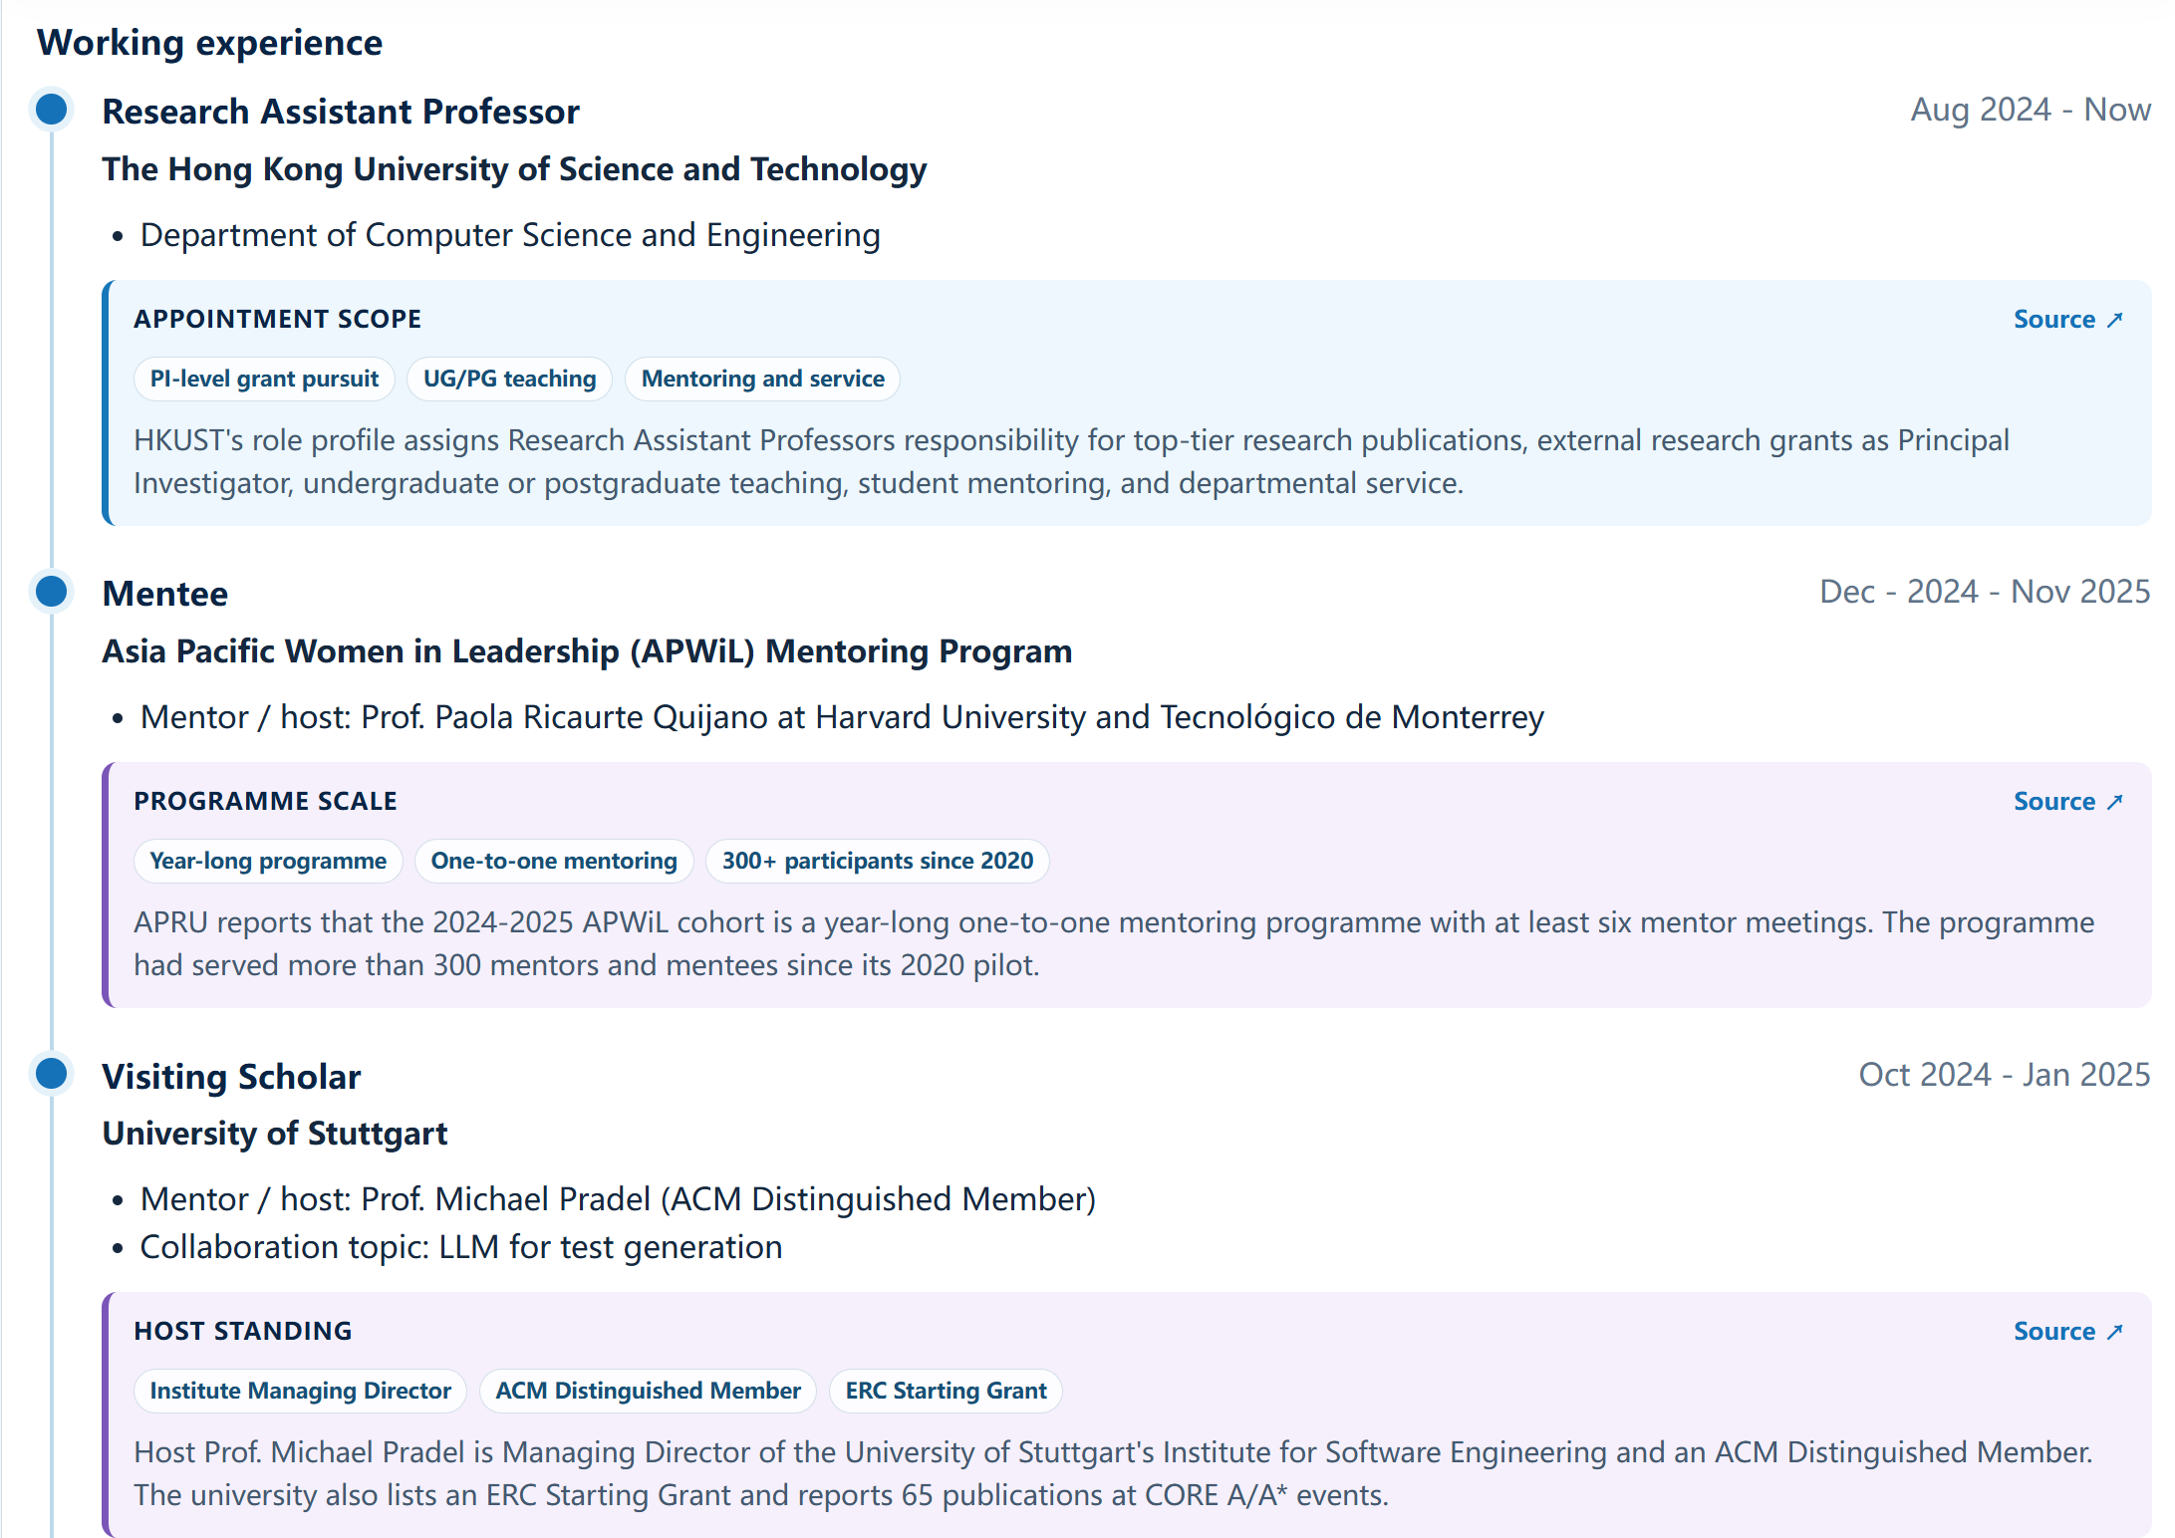

Slide 19
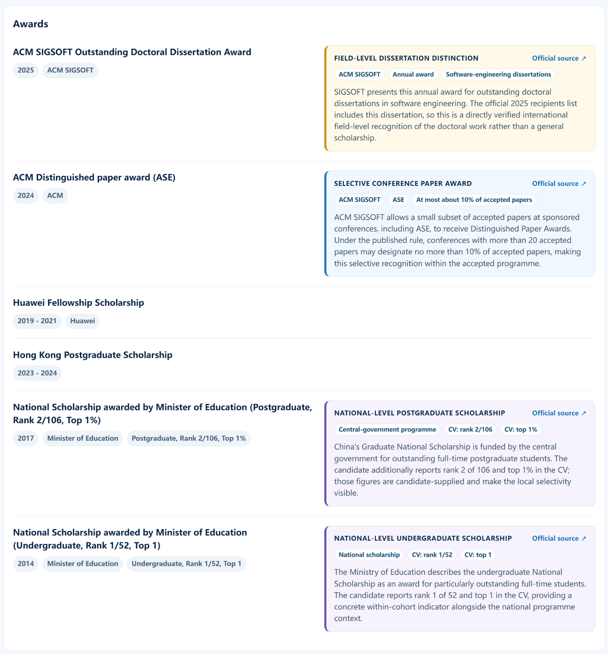
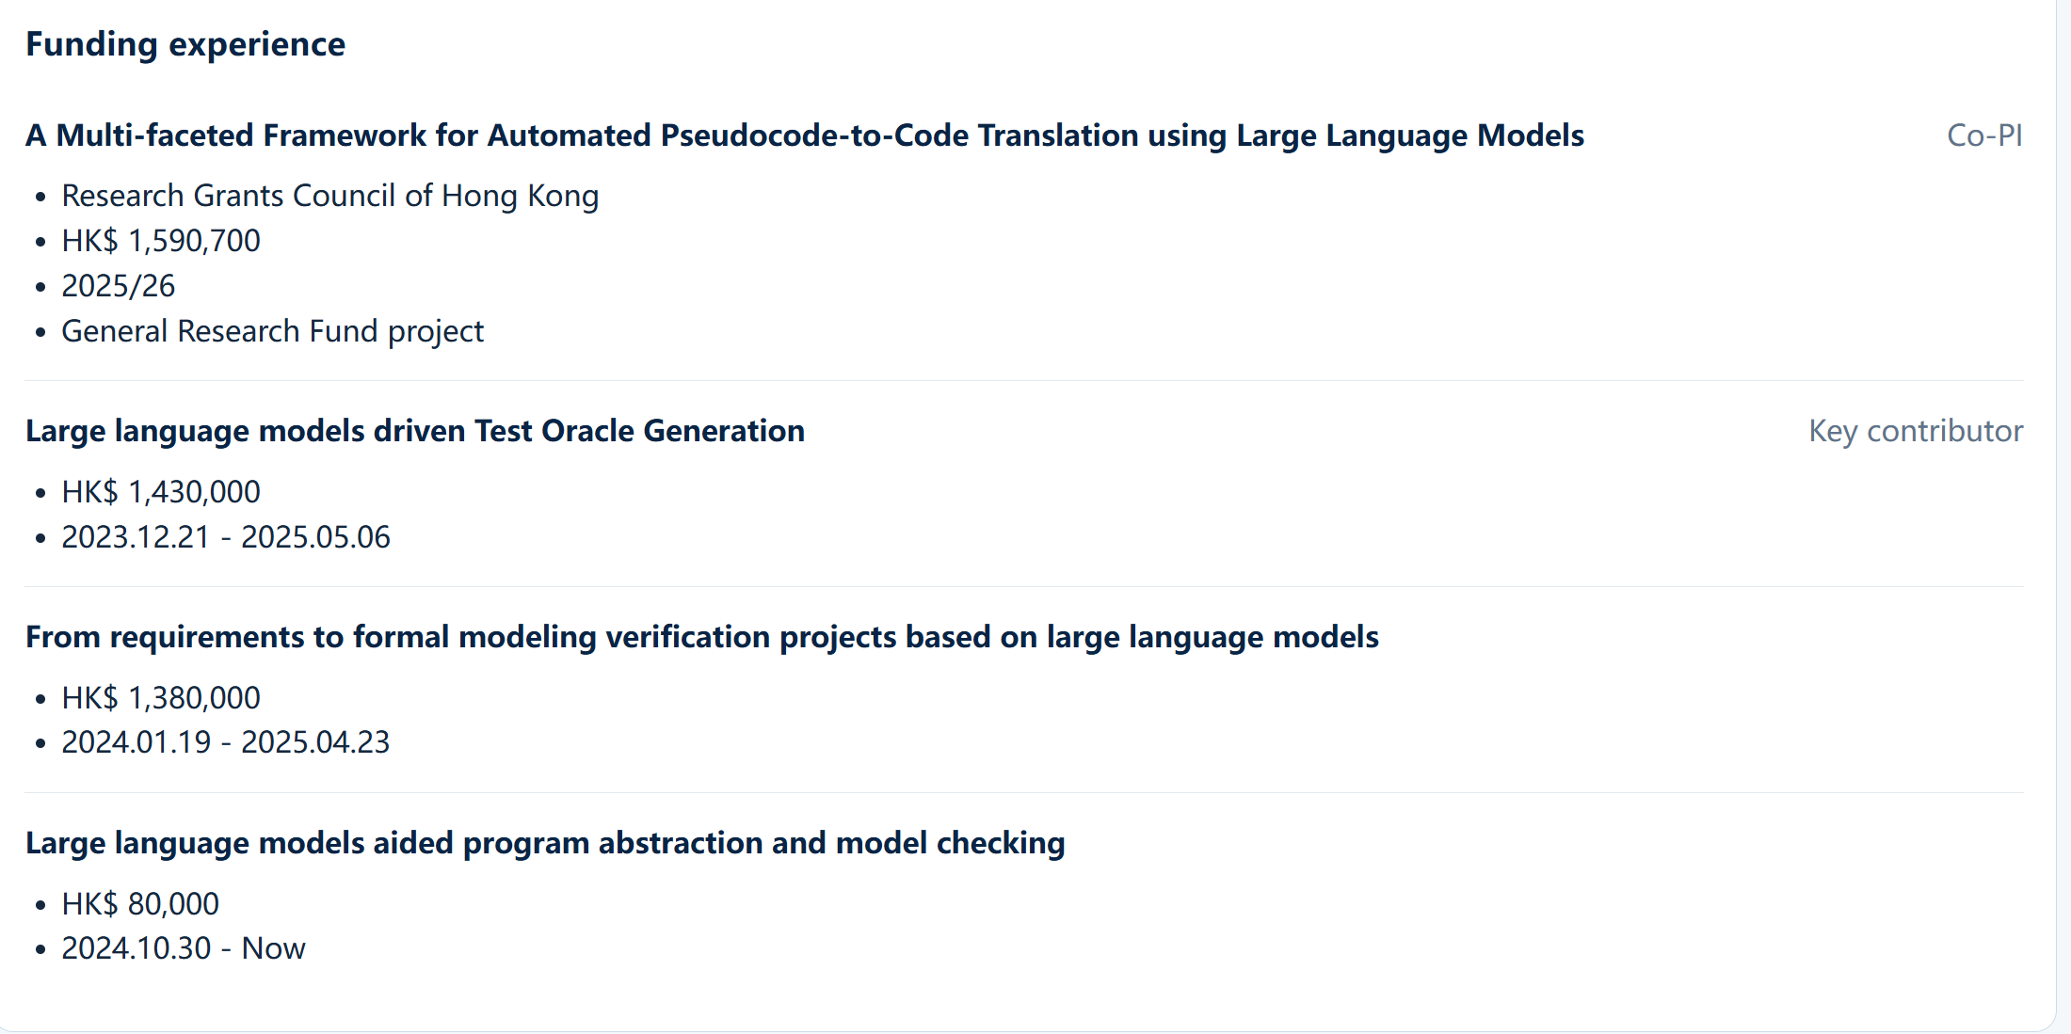

Slide 20
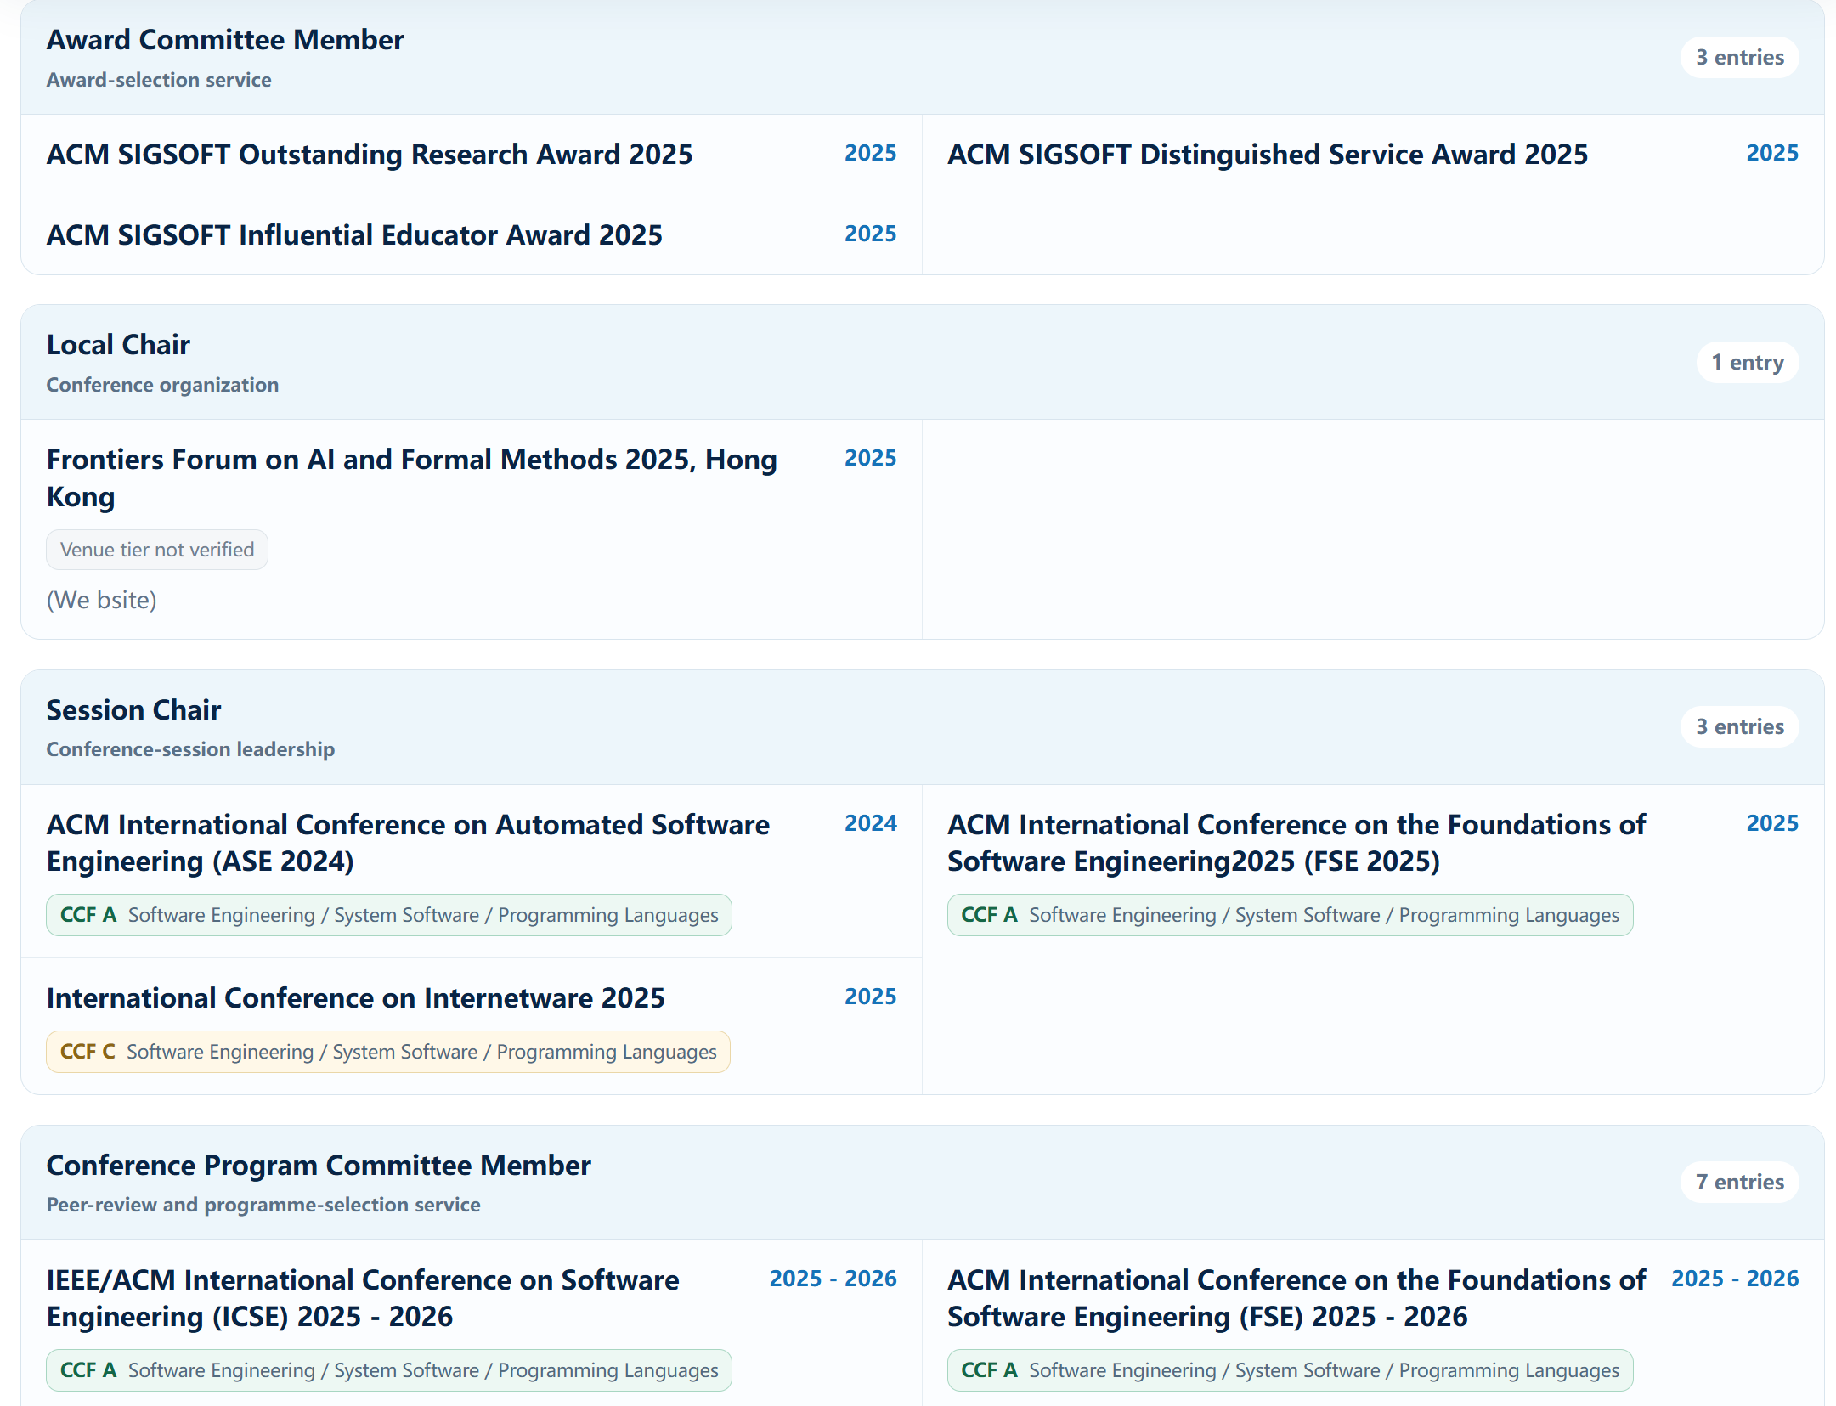
Professional services
Suggested Information to Record
Journal or conference name
Role: reviewer, editorial board member, program committee member, etc.
Service year or term
Research area of the journal or conference
10
Notes:
Reviewing and academic service roles should be distinguished carefully: reviewer, editorial board member, and conference program committee member are not interchangeable. Self-reported items from a CV may be retained, but they should be clearly separated from records that have been verified through public webpages or other evidence. Failure to find a public list does not prove that the experience is false; the system should preserve the original claim and label its evidence status. The main analysis here is the nature of the service and its relevance to the candidate’s professional area.

Slide 21
